Slide 1
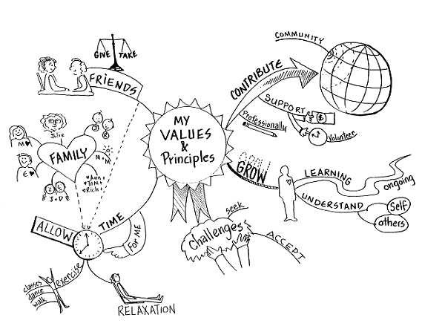
Core Values?
1
Relationships
&
Connections

Slide 2
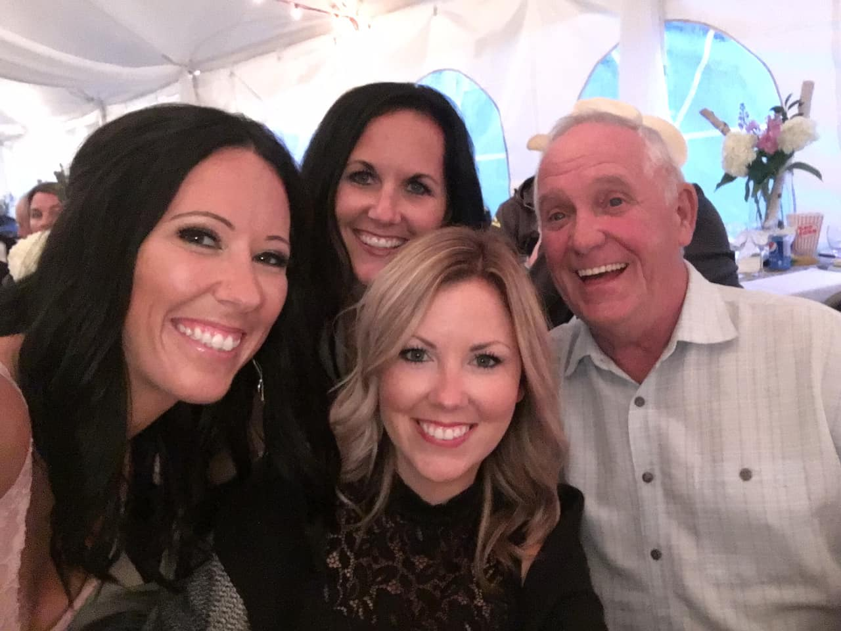
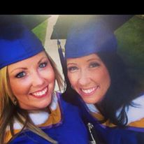
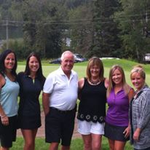
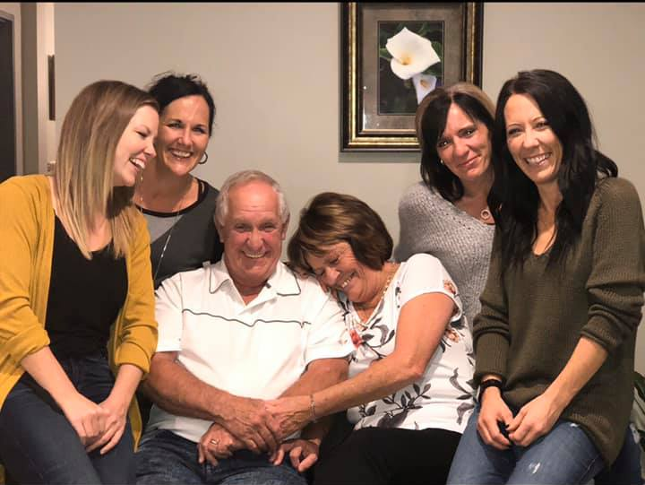
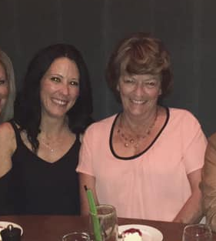

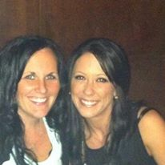

Slide 3
“SMART” Philosophy
3
See the person before the employee
Make connections
Actions speak louder than words
Recognize leaders and strengths
Trust and respect your staff

Slide 4

See the child before the student
&
See the person before the employee

Slide 5

Make Connections
5

Slide 6
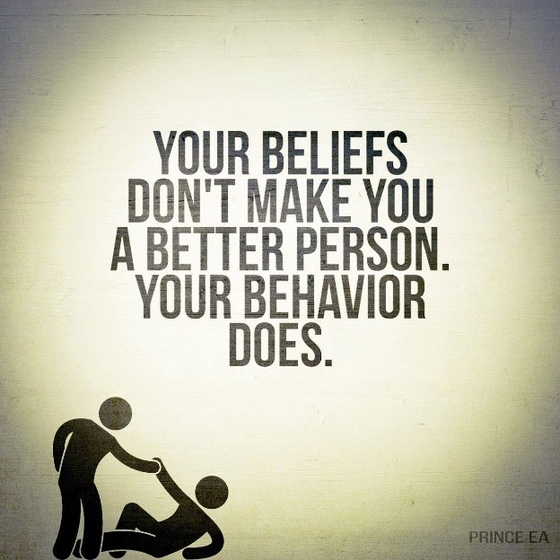
Actions
Speak Louder Than
Words

Slide 7

Recognize Leaders
&
Strengths
7

Slide 8
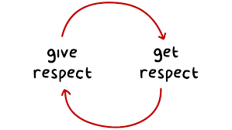
Trust
&
Respect

Slide 9
Thank you!
References:
Couros, G. (2014, November 16). Educational Leadership Philosophy. Retrieved May 5, 2020, from https://georgecouros.ca/blog/presentation-resources/educational-leadership-philosophy
Couros, G. (2018, August 14). 3 Things I Look for in a Leader. Retrieved May 5, 2020, from https://georgecouros.ca/blog/archives/8444
DuFour, R., & Mattos, M. (2013). How Do Principals Really IMPROVE SCHOOLS? Educational Leadership, 70(7), 34-40. Retrieved from eBook Collection (EBSCOhost) database.
Goleman, D. (2013, December). The Focused Leader. Harvard Business Review.

